Slide 1
The Cool Code Consortium
7-20-2017
Notes:
Use this for Pro Audio Segments

Slide 2
Stuff
Cool News
Digital Signal Processing
Next Week

Slide 3
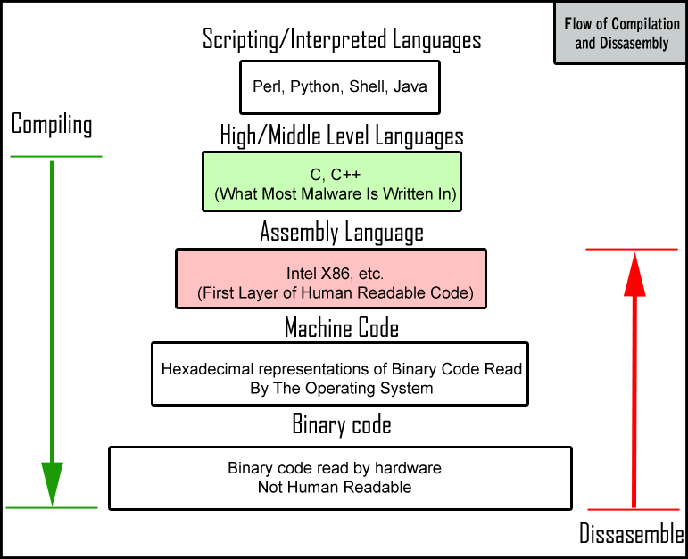

Slide 4
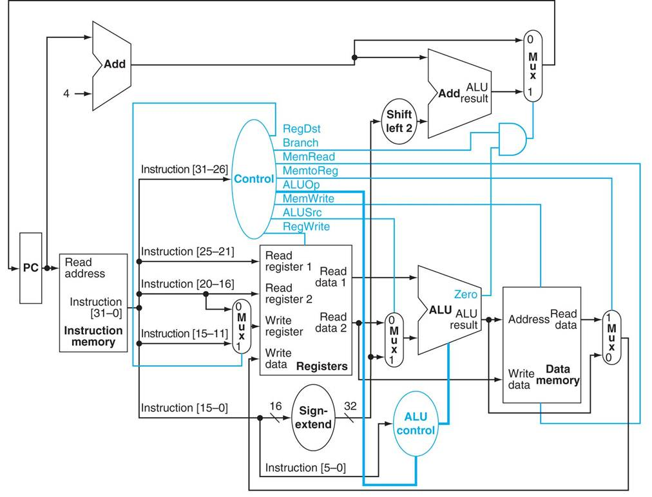

Slide 5
Cool News
DeepMind AI learns to Walk: https://www.engadget.com/2017/07/10/google-deepmind-ai-learns-creative-parkour/
DeepMind AI Paper on Relational Reasoning: https://www.youtube.com/watch?v=vzg5Qe0pTKk&feature=share
MarI/O Neural Network On Level 1 of Mario: https://www.youtube.com/watch?v=qv6UVOQ0F44
NASA JUNO SpaceCraft Investegating Jupiter: https://www.theverge.com/2017/7/10/15946790/nasa-juno-jupiter-great-red-spot-perijove-flyby
First Successful Child having a hand transplanted to him: http://www.cnn.com/2017/07/19/health/hand-transplant-zion-harvey-study/index.html

Slide 6
Digital Signal Processing

